Slide 1
History of Data Models
Hierarchical Model
Network Model
Relational Model
Object-oriented Data Models
Object-Relational Models

Slide 2
14-4 DATABASE MODELS
A database model defines the logical design of data. The model also describes the relationships between different parts of the data. In the history of database design, three models have been in use: the hierarchical model, the network model and the relational model.

Slide 3
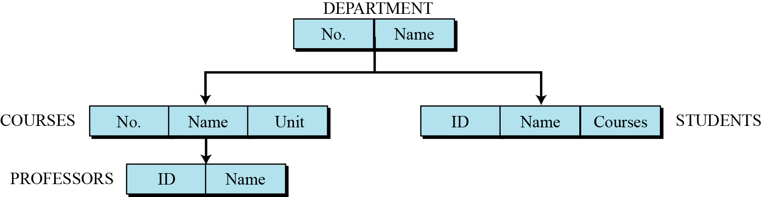
Hierarchical database model
In the hierarchical model, data is organized as an inverted tree. Each entity has only one parent but can have several children. At the top of the hierarchy, there is one entity, which is called the root.
Figure 14.3 An example of the hierarchical model representing a university

Slide 4
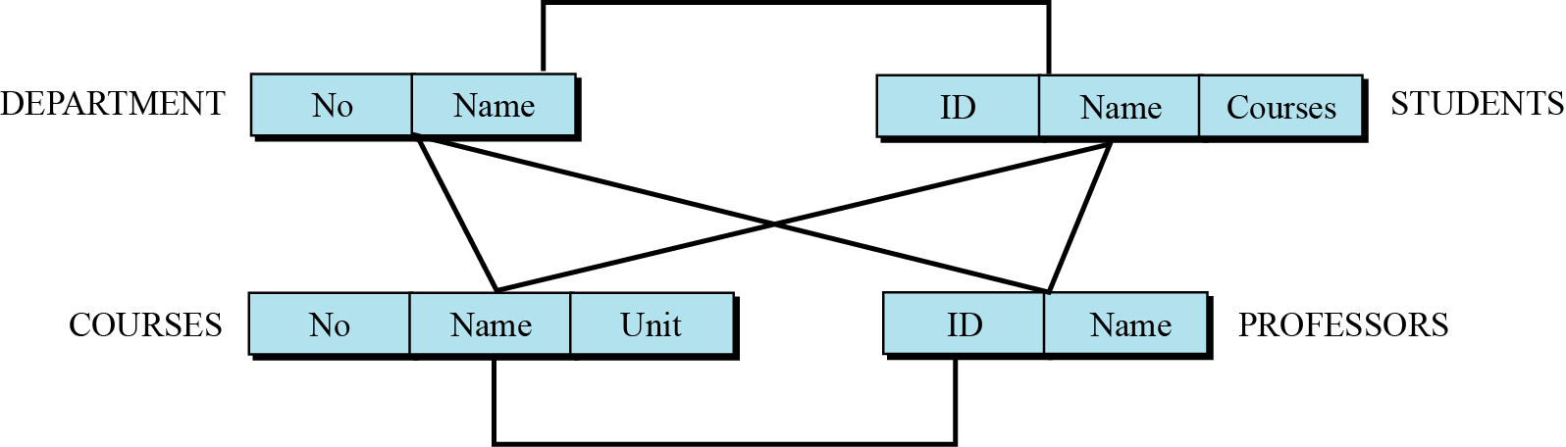
Network database model
In the network model, the entities are organized in a graph, in which one entity can be accessed through several paths (Figure 14.4).
Figure 14.4 An example of the network model representing a university

Slide 5
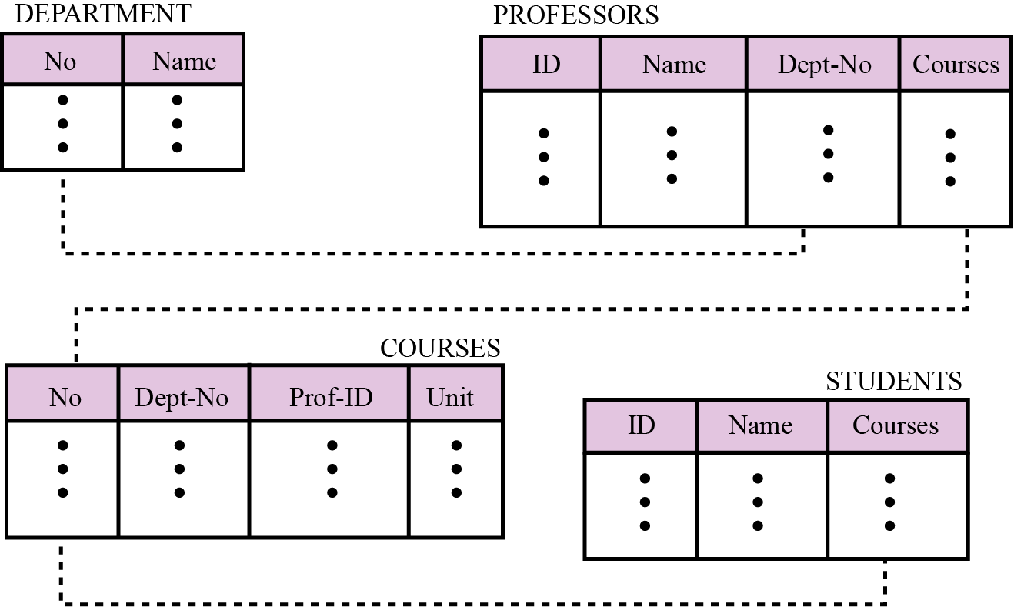
Relational database model
In the relational model, data is organized in two-dimensional tables called relations. The tables or relations are, however, related to each other.
Figure 14.5 An example of the relational model representing a university

Slide 6
Outline
Relational Model
History
Concepts
Constraints

Slide 7
Relational Model History
Introduced by Ted Codd in 1970
Ted Codd was an IBM Research Fellow
Laid the foundation for database theory
Many database concepts & products based on this model

Slide 8
Why is the relational model so popular?
supported by a mathematical model
relations (tables) are a good tool for communicating information to users and developers
efficient implementations exist for the storing of relational information in the form of Relational DBMSs (RDBMSs)

Slide 9
What is a Relation?
A Relation is a 2-dimensional table of values (rows and columns)
each row, or tuple, is a collection of related facts
the degree of the relation is the number of attributes in the relation
each column represents an attribute
each row is an instance of the relation

Slide 10
What is a Relation (cont’d)?
So, a relation is a big table of facts.
Each column contains the attribute data with the data type
Each row describes a real-world instance of the relation
A Relational database contains one or more relations (or tables).

Slide 11
Schema vs. Instance
the name of the relation and the set of attributes is called the schema (or the intension)
the current values in the relation represent an instance (or extension) of the data

Slide 12
More formally……
A domain D is a set of atomic values
local phone number – The set of 7-digit numbers
names – The set of names of persons
date of birth – Possible dates of birth for people
A relation schema R(A₁, A₂, …, A_{n}) is a:
relation name (R)
list of attributes (A₁, A₂, …, A_{n})
each attribute A_{i} is the name of a role played by some domain D in the relation schema R

Slide 13
14-8 OTHER DATABASE MODELS
The relational database is not the only database model in use today. Two other common models are distributed databases and object-oriented databases. We briefly discuss these here.

Slide 14
Distributed databases
The distributed database model is not a new model, but is based on the relational model. However, the data is stored on several computers that communicate through the Internet or a private wide area network. Each computer (or site) maintains either part of the database or the whole database.
Fragmented distributed databases
In a fragmented distributed database, data is localized—locally used data is stored at the corresponding site. However, this does not mean that a site cannot access data stored in another site. Access is mostly local, but occasionally global.

Slide 15
Replicated distributed databases
In a replicated distributed database, each site holds an exact replica of another site. Any modification to data stored in one site is repeated exactly at every site. The reason for having such a database is security. If the system at one site fails, users at that site can access data from another site.

Slide 16
Object-oriented databases
An object-oriented database tries to keep the advantages of the relational model and at the same time allows applications to access structured data. In an object-oriented database, objects and their relations are defined. In addition, each object can have attributes that can be expressed as fields.
XML
The query language normally used for objected-oriented databases is XML (Extensible Markup Language). XML was originally designed to add markup information to text documents, but it has also found its application as a query language in databases. XML can represent data with nested structures.

Slide 17
Extended Relational Data Model (ERDM)
Semantic data model
Developed in response to increasing complexity of applications
Based heavily on relational model
Relational DB response to OODM
Primarily geared to business applications
Typically scientific or engineering apps
Object/relational database management system (O/RDBMS)
DBMS based on the ERDM

Slide 18
14.5 THE RELATIONAL DATABASE MODEL in detail
In the relational database management system (RDBMS), the data is represented as a set of relations.

Slide 19
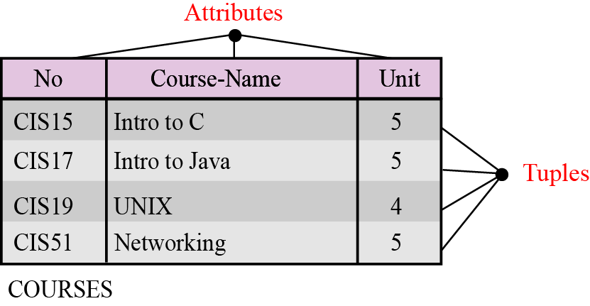
Relations
A relation appears as a two-dimensional table. The RDBMS organizes the data so that its external view is a set of relations or tables. This does not mean that data is stored as tables: the physical storage of the data is independent of the way in which the data is logically organized.
Figure 14.6 An example of a relation

Slide 20
A relation in an RDBMS has the following features:
Name. Each relation in a relational database should have a name that is unique among other relations.
Attributes. Each column in a relation is called an attribute. The attributes are the column headings in the table in Figure 14.6.
Tuples. Each row in a relation is called a tuple. A tuple defines a collection of attribute values. The total number of rows in a relation is called the cardinality of the relation. Note that the cardinality of a relation changes when tuples are added or deleted. This makes the database dynamic.

Slide 21
14-6 OPERATIONS ON RELATIONS
In a relational database we can define several operations to create new relations based on existing ones. We define nine operations in this section: insert, delete, update, select, project, join, union, intersection and difference. Instead of discussing these operations in the abstract, it describes each operation as defined in the database query language named SQL (Structured Query Language).

Slide 22
Structured Query Language
Structured Query Language (SQL) is the language standardized by the American National Standards Institute (ANSI) and the International Organization for Standardization (ISO) for use on relational databases. It is a declarative rather than procedural language, which means that users declare what they want without having to write a step-by-step procedure. The SQL language was first implemented by the Oracle Corporation in 1979, with various versions of SQL being released since then.

Slide 23
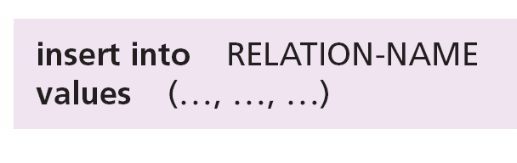
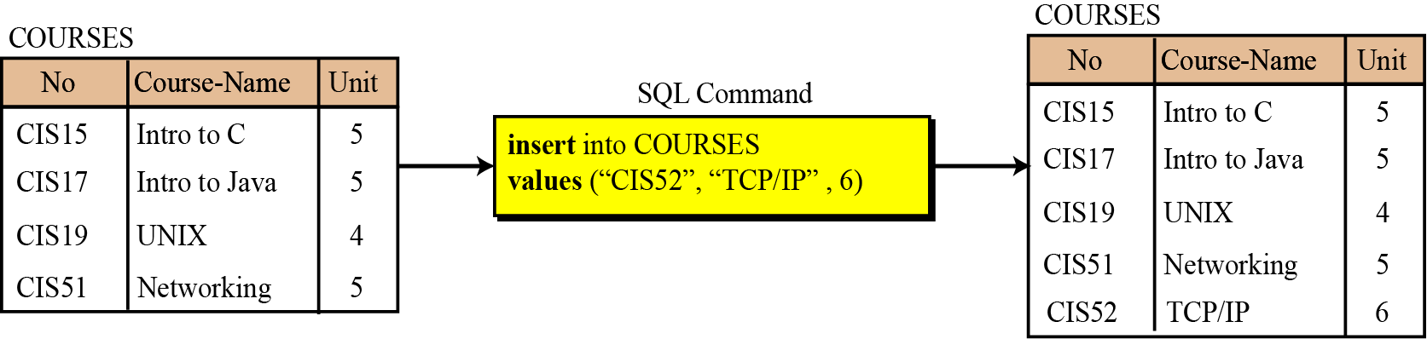
Insert
The insert operation is a unary operation—that is, it is applied to a single relation. The operation inserts a new tuple into the relation. The insert operation uses the following format:
Figure 14.7 An example of an insert operation

Slide 24
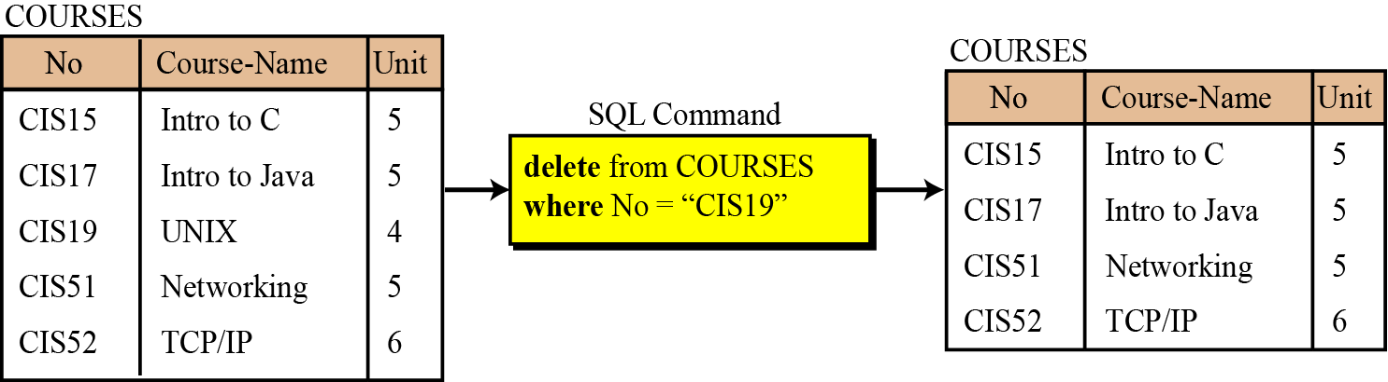
Delete
The delete operation is also a unary operation that is applied to a single relation. The operation deletes a tuple defined by a criterion from the relation. The delete operation uses the following format:
Figure 14.8 An example of a delete operation

Slide 25
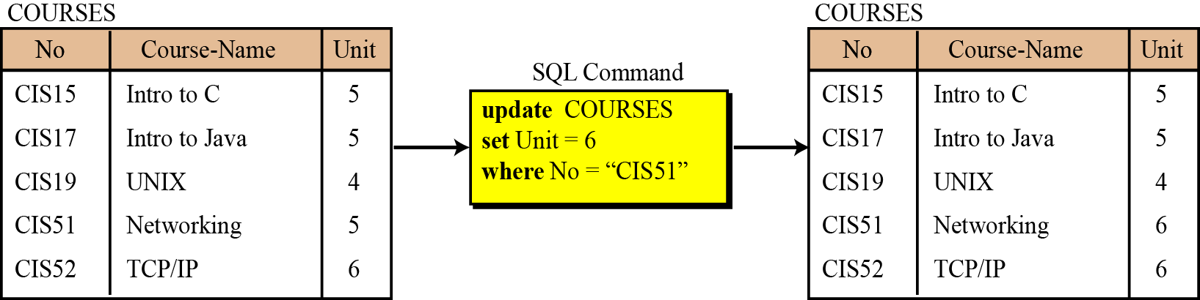
Update
The update operation is also a unary operation that is applied to a single relation. The operation changes the value of some attributes of a tuple. The update operation uses the following format:
Figure 14.9 An example of an update operation

Slide 26
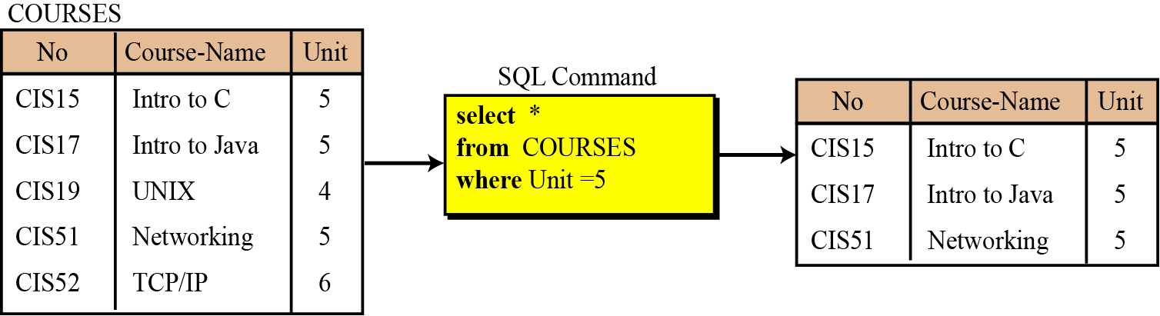
Select
The select operation is a unary operation that is applied to a single relation. The resulting tuples (rows) are a subset of the tuples (rows) in the original relation. The select operation uses the following format:
Figure 14.10 An example of an select operation

Slide 27
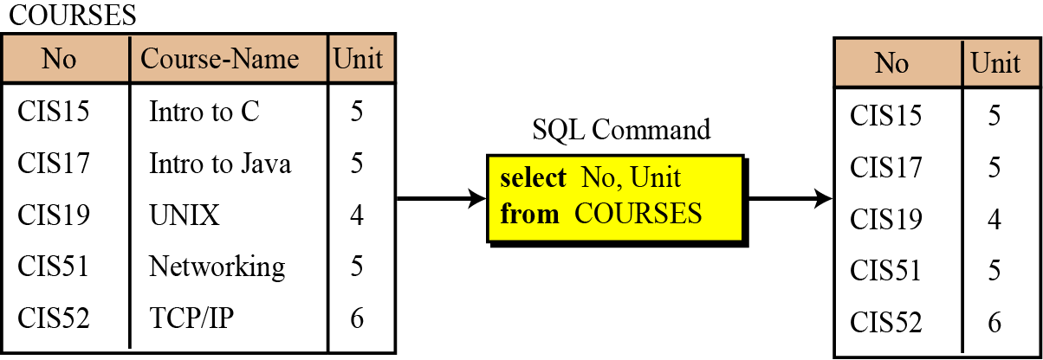
Project
The project operation is also a unary operation and creates another relation temporarily. The attributes (columns) in the resulting relation are a subset of the attributes in the original relation.
Figure 14.11 An example of a project operation

Slide 28
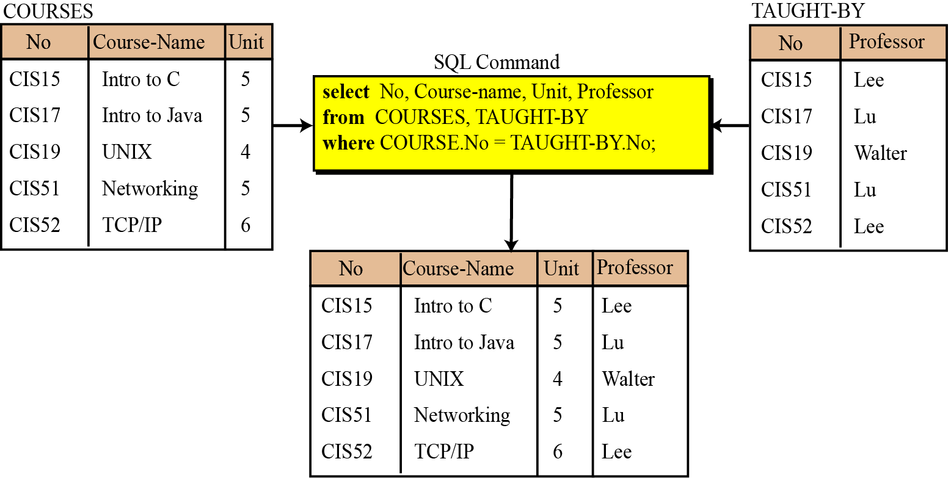
Join
The join operation is a binary operation that combines two relations on common attributes.
Figure 14.12 An example of a join operation

Slide 29
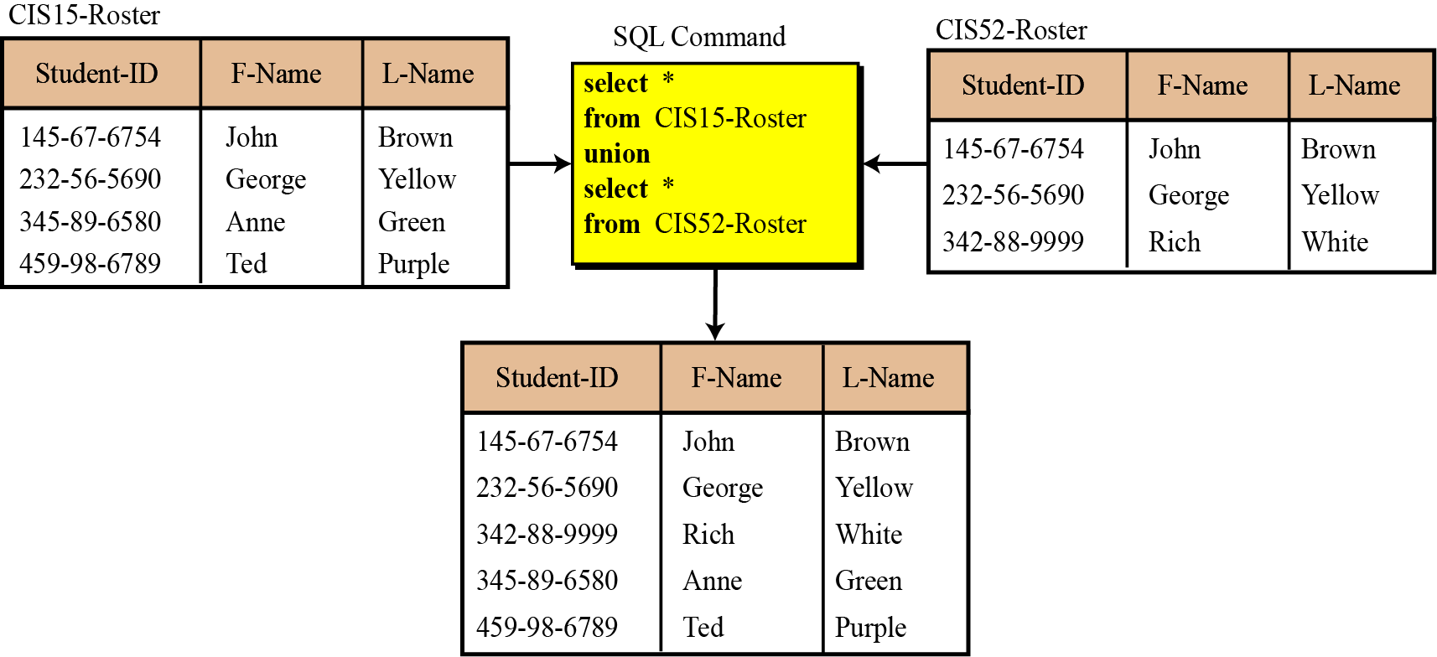
Union
The union operation takes two relations with the same set of attributes.
Figure 14.13 An example of a union operation

Slide 30
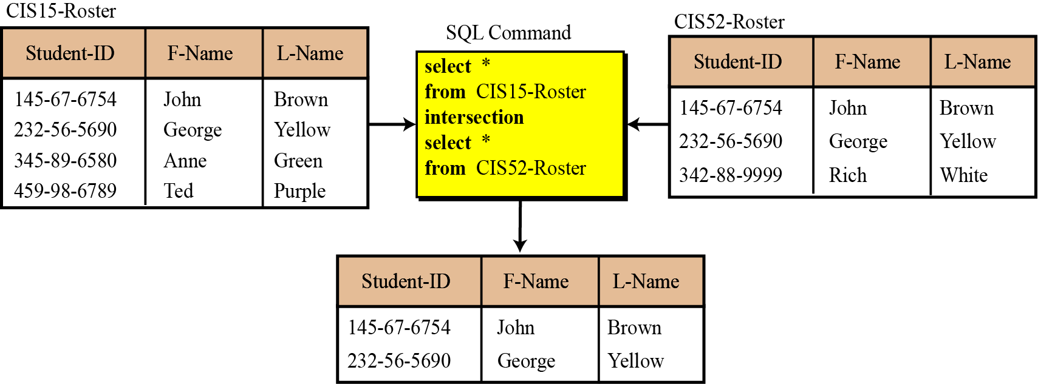
Intersection
The intersection operation takes two relations and creates a new relation, which is the common in the two relations.
Figure 14.14 An example of an intersection operation

Slide 31
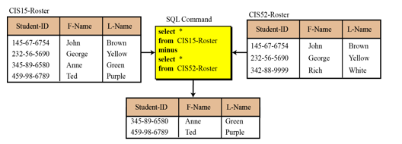
Difference
The difference operation is applied to two relations with the same attributes. The resulting tuples are those that are in the first relation but not in the second relation.
Figure 14.15 An example of a difference operation

